Slide 1
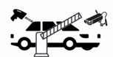
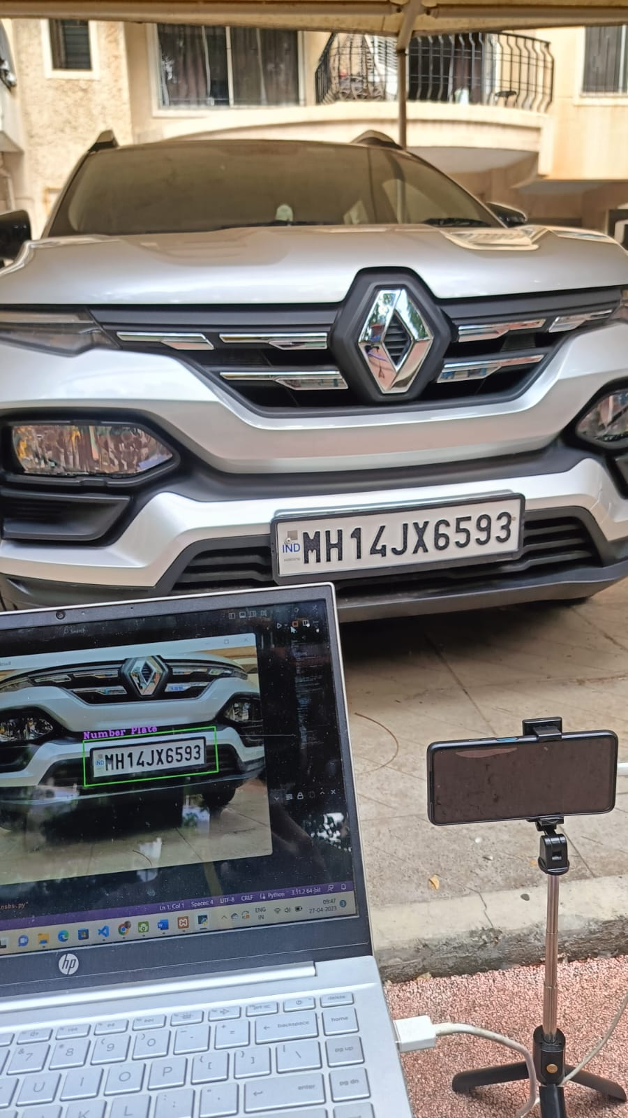
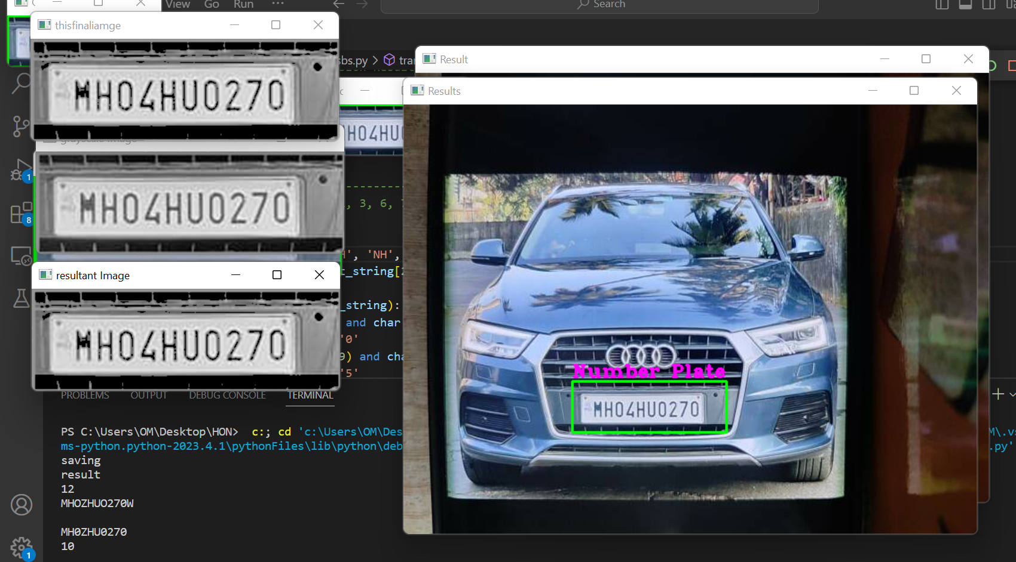
SecureGate –Vehicle Image Processing-Based Billing System
Project by
Om Patil
Neha Shinge
Harsh Rajput

Slide 2
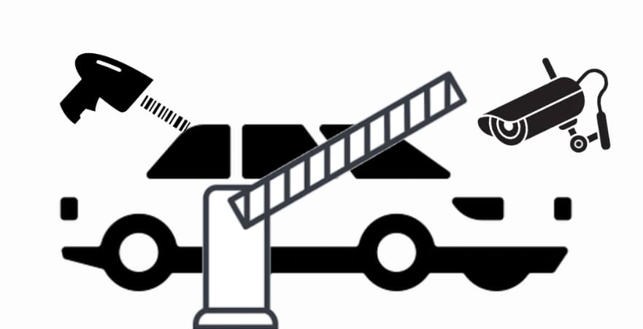
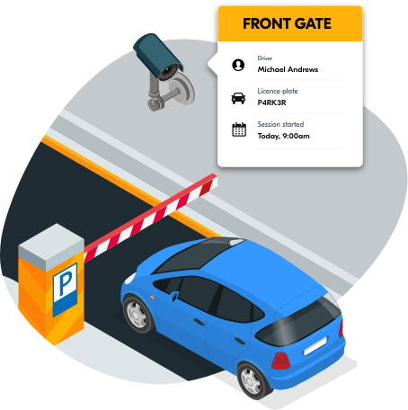
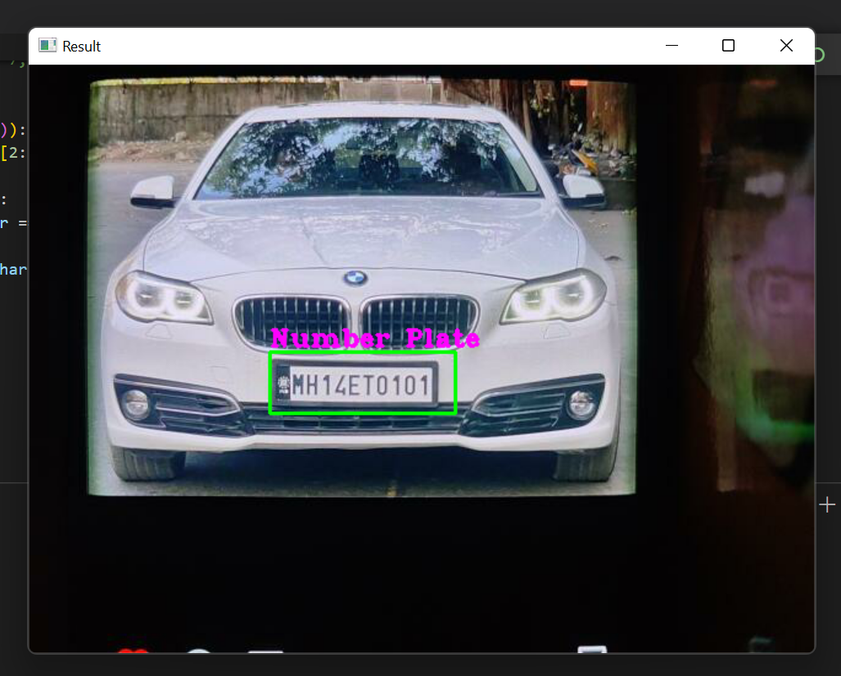
Parking Management System using image processing
Our system is designed to make parking much more advanced efficient and secure .
Our project aims at automating/semi automating vehicle parking billing system along with adding increased security using image processing and recognition.
Our project works by scanning a vehicle that arrives at the entry and detecting its nameplate and id card . Post that it will extract the text within that nameplate as well as id card information and check in the database if it matches with the existing records, if it matches that means that the vehicle is a known vehicle. It will further check if the vehicle is owned by a student or staff in the database and accordingly take action, i.e., if it's if it's a student it will increment parking fee depending if the vehicle is a 4-wheeler or a 2-wheeler.

Slide 3
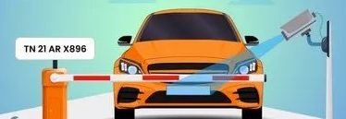


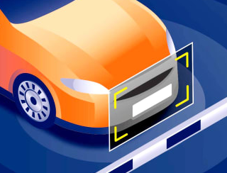
Work responsibilities
Front end development: Harsh Rajput (26304)
Backend database and database architecture: Neha Shinge (226368)
Python algorithm and image processing : Om Patil (226363)

Slide 4
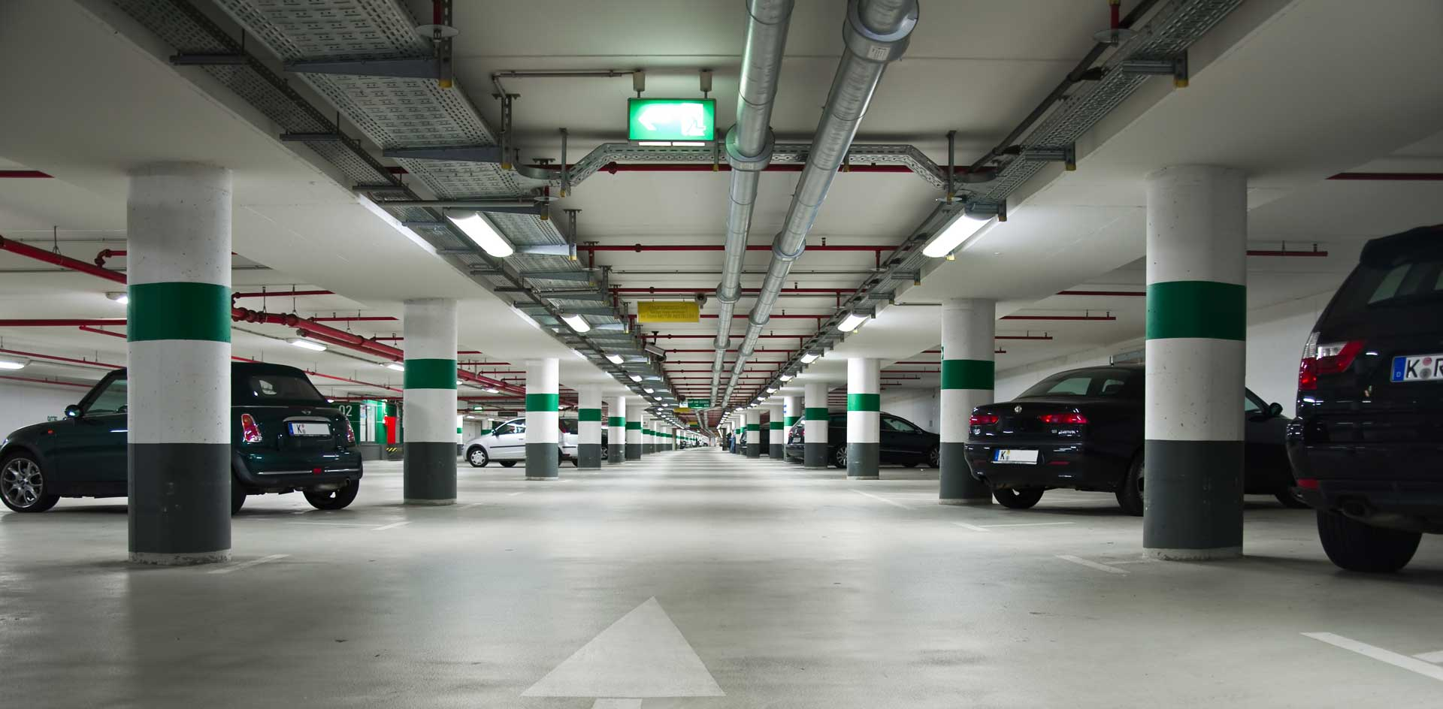
Existing system:
In the existing system comprises of a total human driven manual mechanism of collecting vehicle parking fees and manually noting down the entries.
In The current system a vehicle will arrive at the gate and at the time of arrival the vehicle owner will be told to pay the parking fee, as the gate guard is unaware if the vehicle owner is a student or faculty or guest, he will have to ask the vehicle owner that information and based on that charge him/her.Post that the vehicle will granted entry and permitted to park.

Slide 5
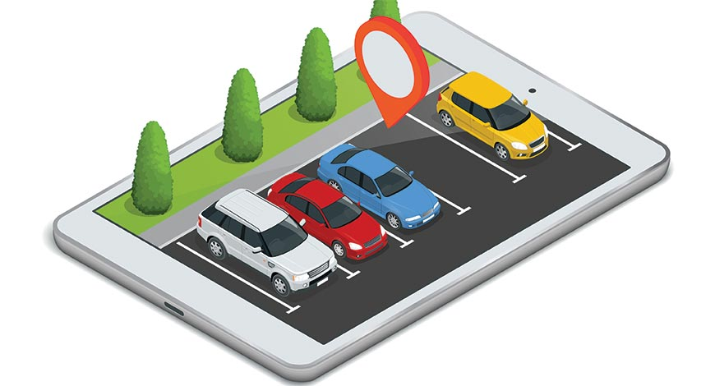
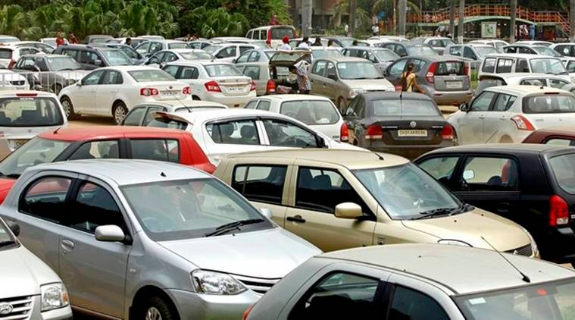
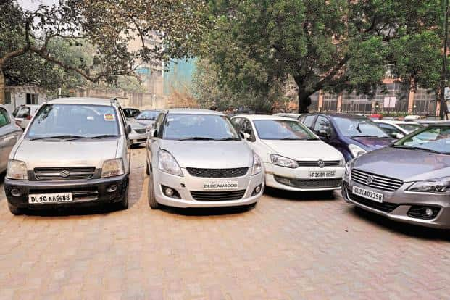
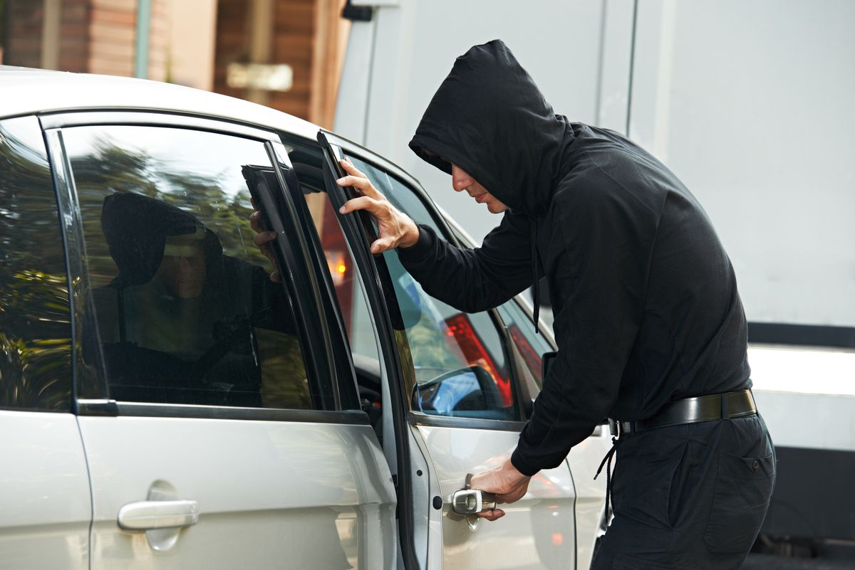
Need of the System
Our designed system is a major improvement requirement to almost all parking systems because our system automates almost the entire process ensuring that no one can cheat the system resulting in giving optimal profit and very high amount of security which the conventional system lacked.
Our system is designed to be flexible so that with little tweaks it can be accommodated for any applications ranging from mall parking to hospitals and even high security stand areas like VIP parking spaces.
Our system will benefit both the client by ensuring maximum profit and also the vehicle owner by ensuring security and proof being maintained about his/her in and outs and vehicle timestamp information.

Slide 6

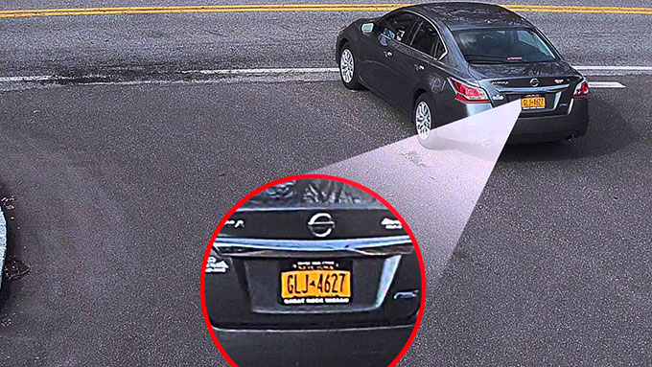
Overview of the project
Our project works by scanning a vehicle that arrives at the entry and detecting its nameplate and the drivers identity card . Post that it will extract the text within that nameplate,id card and checking in the database if both match with the existing records, if it matches that means that the vehicle is a known vehicle. It will further check if the vehicle is owned by a student or staff in the database and accordingly take action, i.e., if it's if it's a student it will increment parking fee depending if the vehicle is a 4-wheeler or a 2-wheeler. And If it's a vehicle belonging to staff it won't charge and directly send permission to open the gate. If the found nameplate does not exist within the database a message to pay the guest fee will be sent to the vehicle owner. In and every entry will be stored in a table called log table along with the timestamp of the vehicle. This will help in security and also help in distinguishing if the vehicle owner came for the first time or nth time the same day and accordingly charge or not charge him/her.

Slide 7

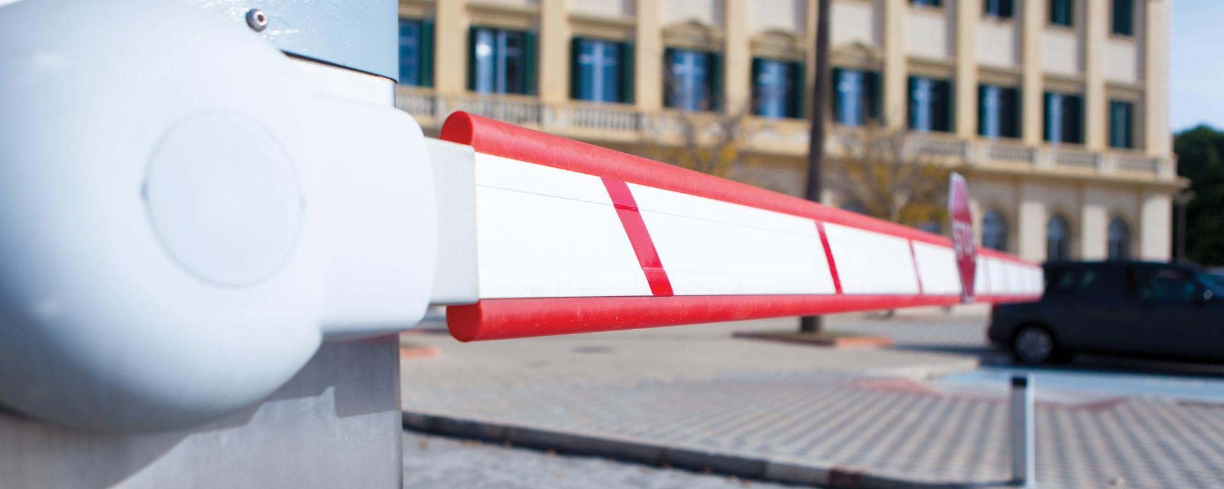
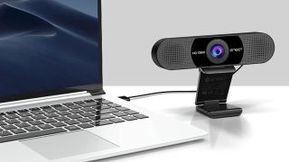
Technical feasibility:
Technical feasibility: The technology required to automate the parking system using nameplate identification must be reliable, accurate, and cost-effective. A detailed technical analysis must be done to ensure that the technology can be implemented and maintained without any significant issues.
In our app we require a physical web camera which will be capable of detecting objects in a minimum HD resolution effortlessly.

Slide 8

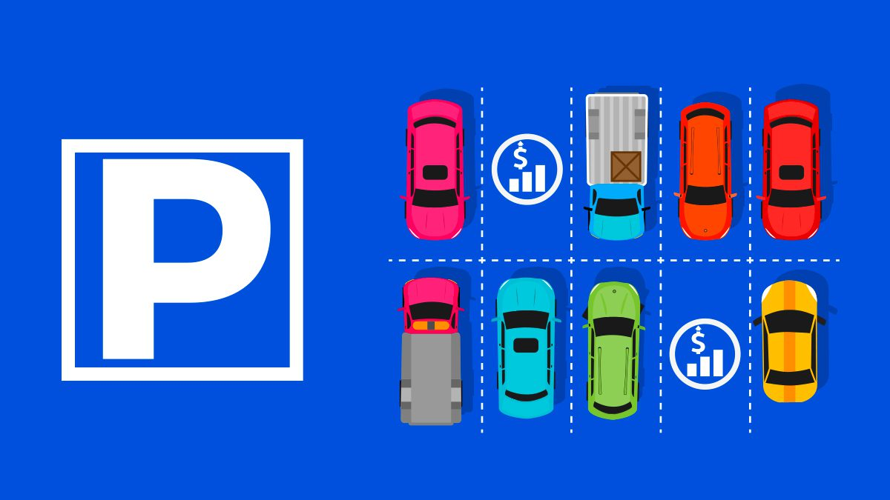
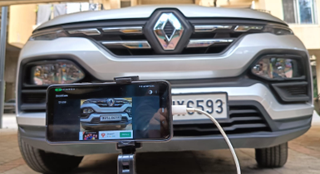
Financial feasibility
Financial feasibility: The cost of implementing the automated parking system must be carefully analyzed to ensure that the institution can afford it. The cost should include the cost of technology installation, maintenance, and operation.
Our project has tried to keep costs at their bare minimum as instead of purchasing a high resolution camera that can be very expensive and costly to replace we are intending of using an olds smartphones inbuilt camera as the default camera or a simple webcam will also work flawlessly .

Slide 9
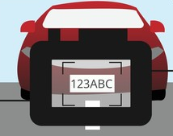
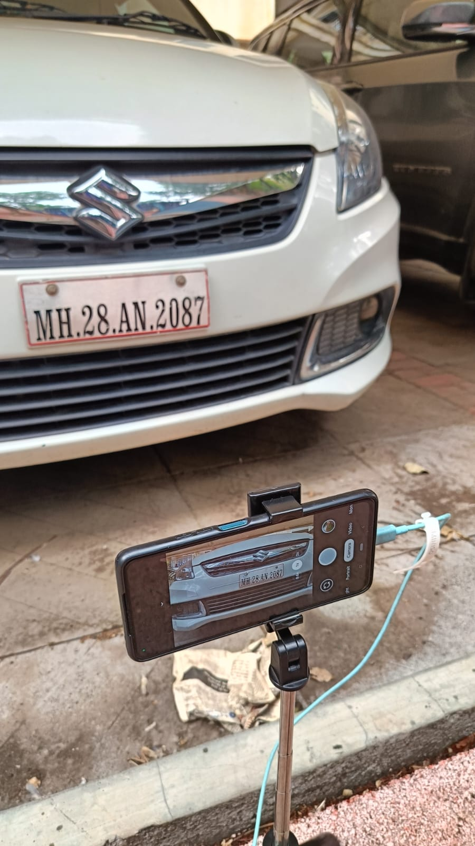
Operational feasibility
The automated parking system must be easy to operate and manage. It should not disrupt the daily operations of the institution, and the staff should be trained to use it efficiently.
The gate watchman will have very minimal interaction with the system he will just have to ensure the images are captured and accept the payment if the nameplate is not recognized .

Slide 10
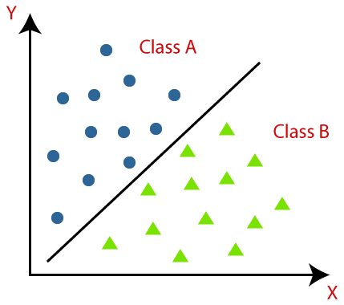
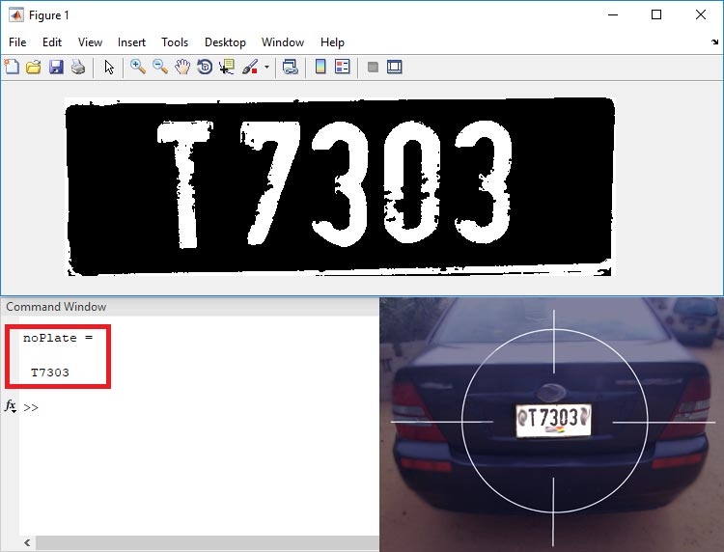
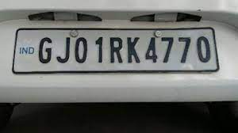
Classification
Haar cascade works as a classifier. It classifies positive data points → that are part of our detected object and negative data points that don't contain our object.
Haar cascades are fast and can work well in real-time.
A cascade function is trained on lots of positive and negative images for detection. The algorithm does not require extensive computation and can run in real-time.
OpenCV provides a training method ( Cascade Classifier Training) or pretrained models, that can be read using the cv::CascadeClassifier::load method.

Slide 11
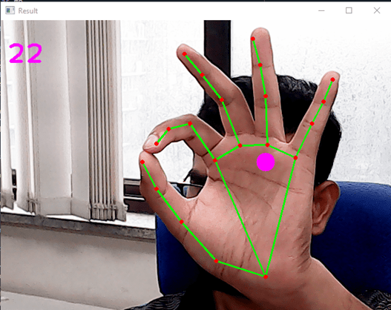
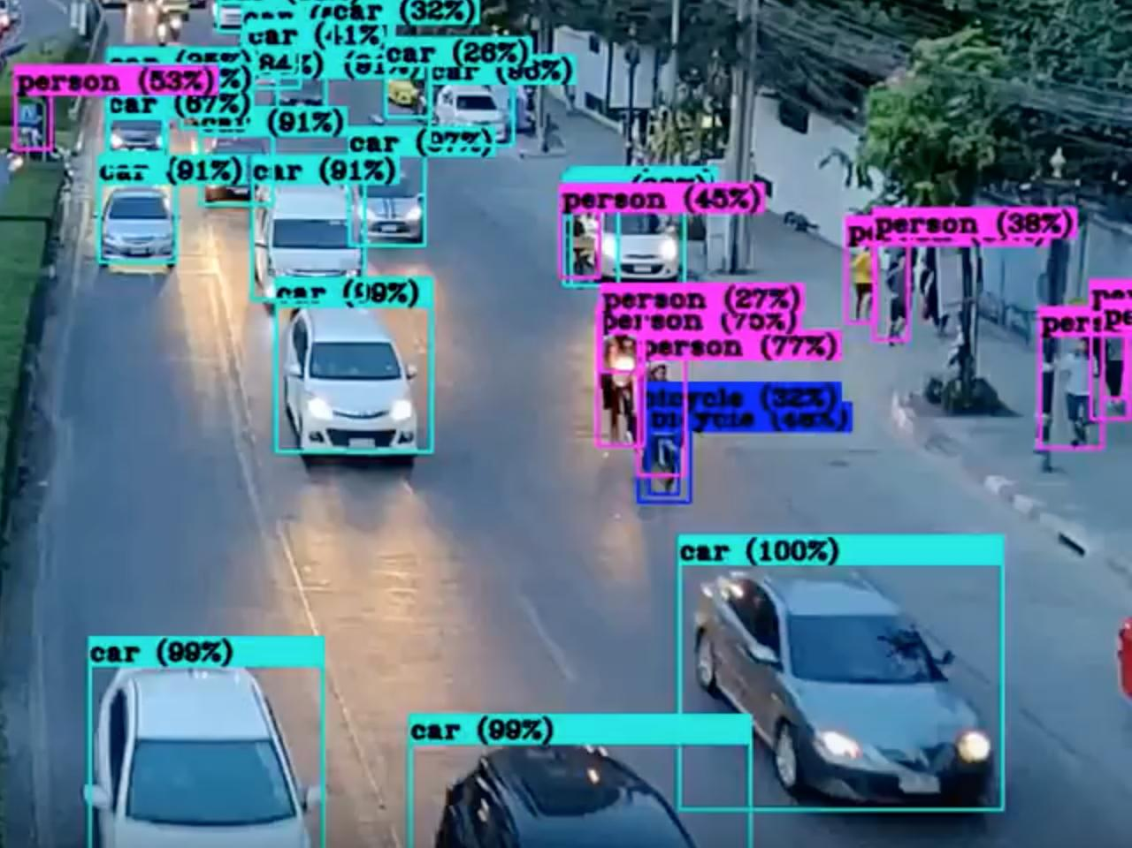

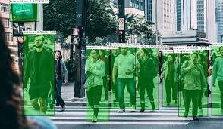
Opencv
OpenCV is a Python library that allows you to perform image processing and computer vision tasks. It provides a wide range of features, including object detection, face recognition, and tracking.
In OpenCV, the CV is an abbreviation form of a computer vision, which is defined as a field of study that helps computers to understand the content of the digital images such as photographs and videos.
The purpose of computer vision is to understand the content of the images. It extracts the description from the pictures, which may be an object, a text description, and three-dimension model, and so on. For example, cars can be facilitated with computer vision, which will be able to identify and different objects around the road, such as traffic lights, pedestrians, traffic signs, and so on, and acts accordingly.

Slide 12

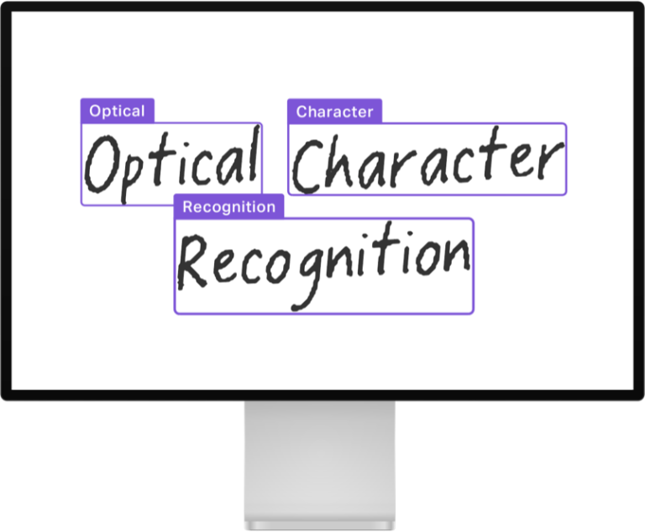
Pytesseract
Python-tesseract is an optical character recognition (OCR) tool for python. That is, it will recognize and “read” the text embedded in images.
Python-tesseract is a wrapper for Google’s Tesseract-OCR Engine. It is also useful as a stand-alone invocation script to tesseract, as it can read all image types supported by the Pillow and Leptonica imaging libraries, including jpeg, png, gif, bmp, tiff, and others. Additionally, if used as a script, Python-tesseract will print the recognized text instead of writing it to a file.

Slide 13
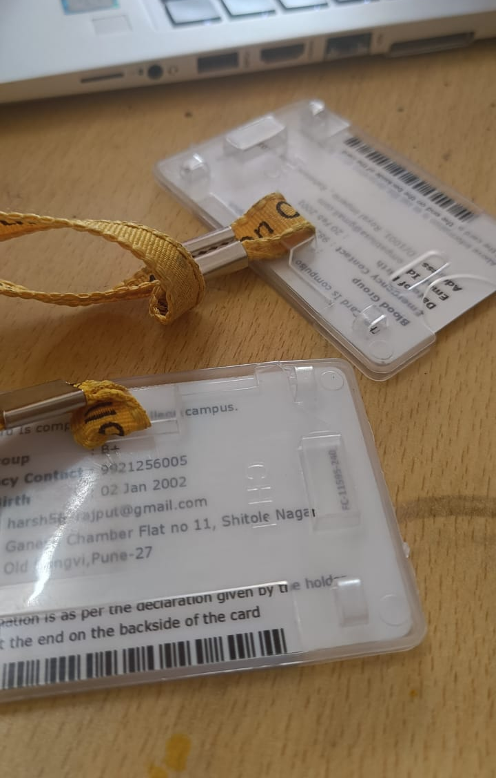

Pyzbar library
We have used pyzbar library for scanning barcodes
Pyzbar is a Python library for decoding barcodes and QR codes from images and video streams. It is built on top of the ZBar library, which is a widely used open-source software suite for reading barcodes from various sources.
We have used this library to scan make a barcode scanner that will scan our id card and display the value .

Slide 14


gTTS
gTTS, which stands for "Google Text-to-Speech," is a Python library and CLI tool that allows you to convert text into spoken language using Google's Text-to-Speech API. It enables you to generate audio files from text, making it easy to add speech synthesis capabilities to your Python applications.
Text-to-Speech Conversion: gTTS is primarily used for converting text-based content, such as sentences, paragraphs, or even entire documents, into audio speech. You provide the text you want to convert, and gTTS generates an audio file (typically in MP3 format) that contains the spoken version of that text.
We are using this library to alert the vehicle owner his/her approval status

Slide 15


Wireless Camera
Our project now uses a wireless camera as an external camera to capture the vehicle .
This opens a wide range of flexibility for the user and allows the camera to be positioned away from the actual processing device and database, This ensures that we will not have to carry the camera with the system around.

Slide 16

New UI with logo
We enhanced the ui as well as the ux , the ui is more company centric and emphasises on our goal
The user interface of our code has undergone significant enhancements, resulting in a visually appealing and user-friendly experience. Our revamped UI combines aesthetic design with intuitive functionality, making it more accessible and engaging for users. The thoughtful layout and improved navigation ensure that users can seamlessly interact with our application, while the updated aesthetics create a modern and visually pleasing environment. These enhancements not only elevate the overall user experience but also showcase our commitment to providing a polished and attractive interface that complements the power and functionality of our code

Slide 17
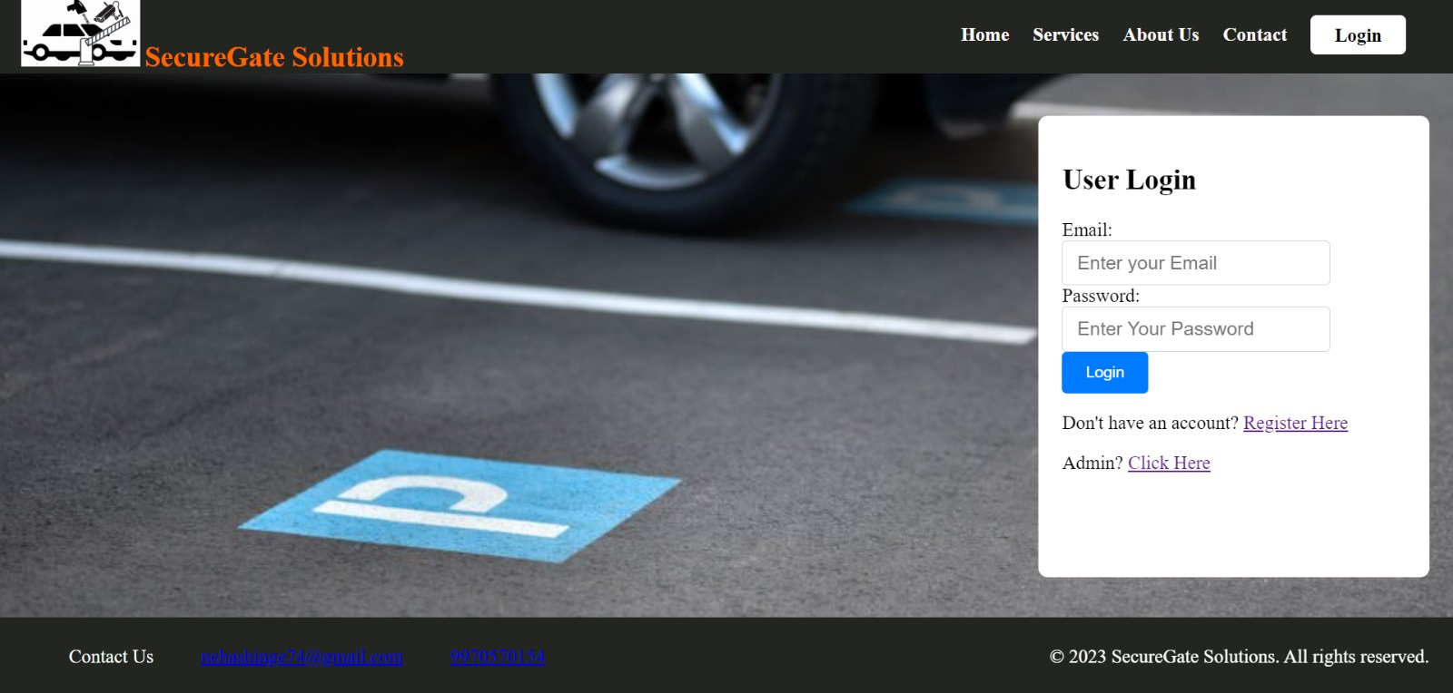

Slide 18
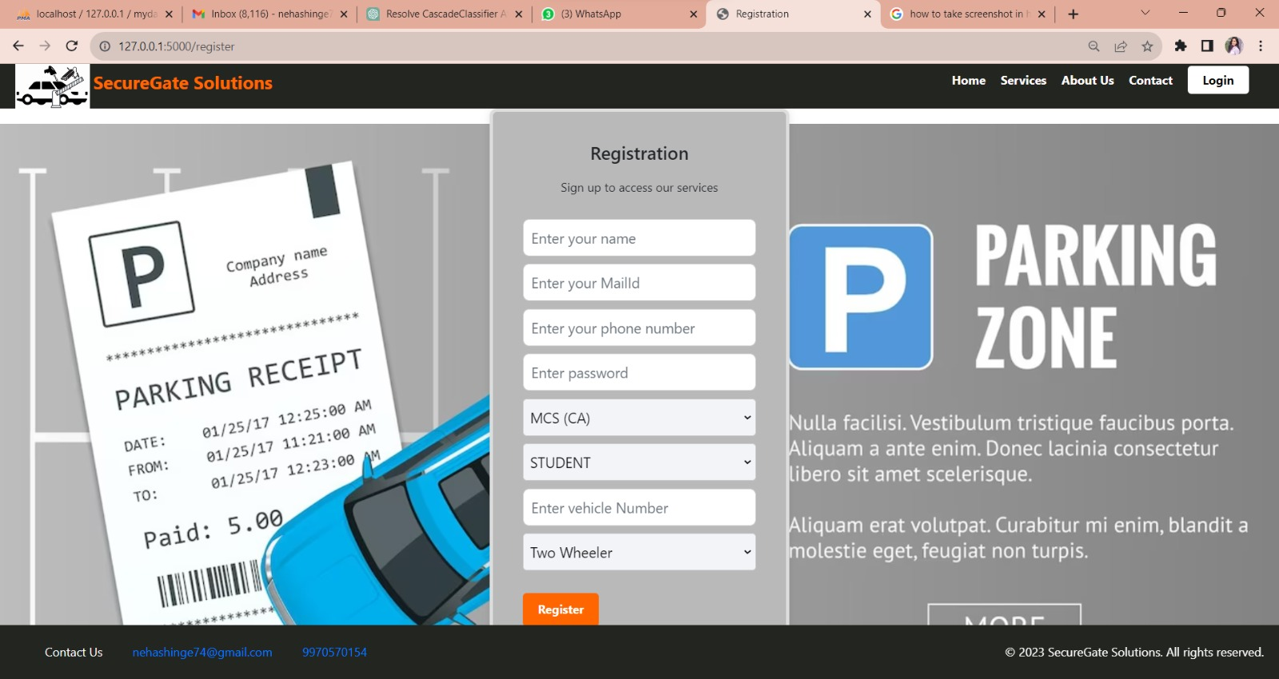

Slide 19
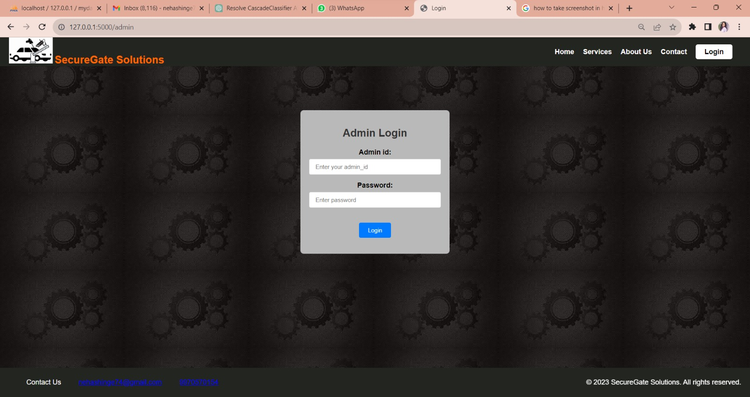

Slide 20


Flask
Flask is a micro web framework written in python. Micro-framework is normally a framework with little to no dependencies on external libraries. Though being a micro framework almost everything can be implemented using python libraries and other dependencies when and as required. Some reasons we we chose it over PHP are
Scalable. Size is everything, and Flask's status as a microframework means that you can use it to grow a tech project such as a web app incredibly quickly.
Flexible
Easy to debug
Lightweight

Slide 21
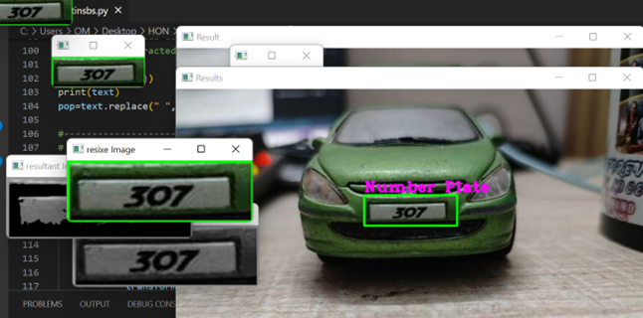
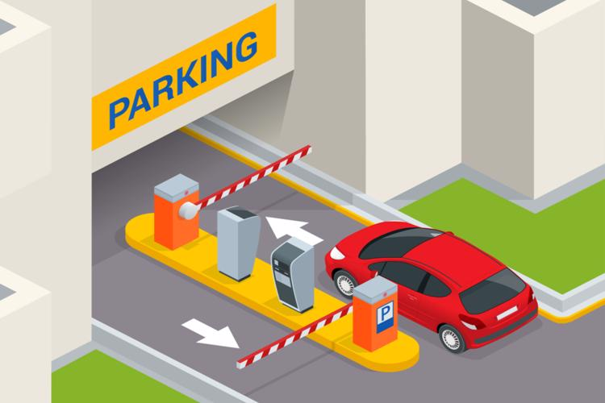
Working
We will be demonstrating how our system works
First the vehicle will come on the gate ,after this our software will detect the
Id card after which it will scan vehicles nameplate from the vehicle in real time .
Post this it will create a cropped image of the vehicle nameplate obtained and this image will be further sent for image OCR processing .
The OCR via pystesseract will apply filtering logic to the selected threshold image and will extract the output text .
If the record is found it will prompt the user verbally that he/she is approved else it will prompt them that they are not approved

Slide 22
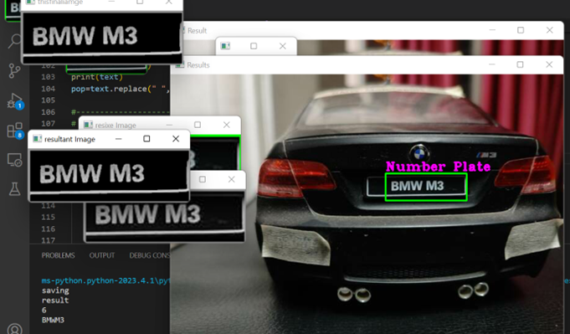
Real Life Working

Slide 23
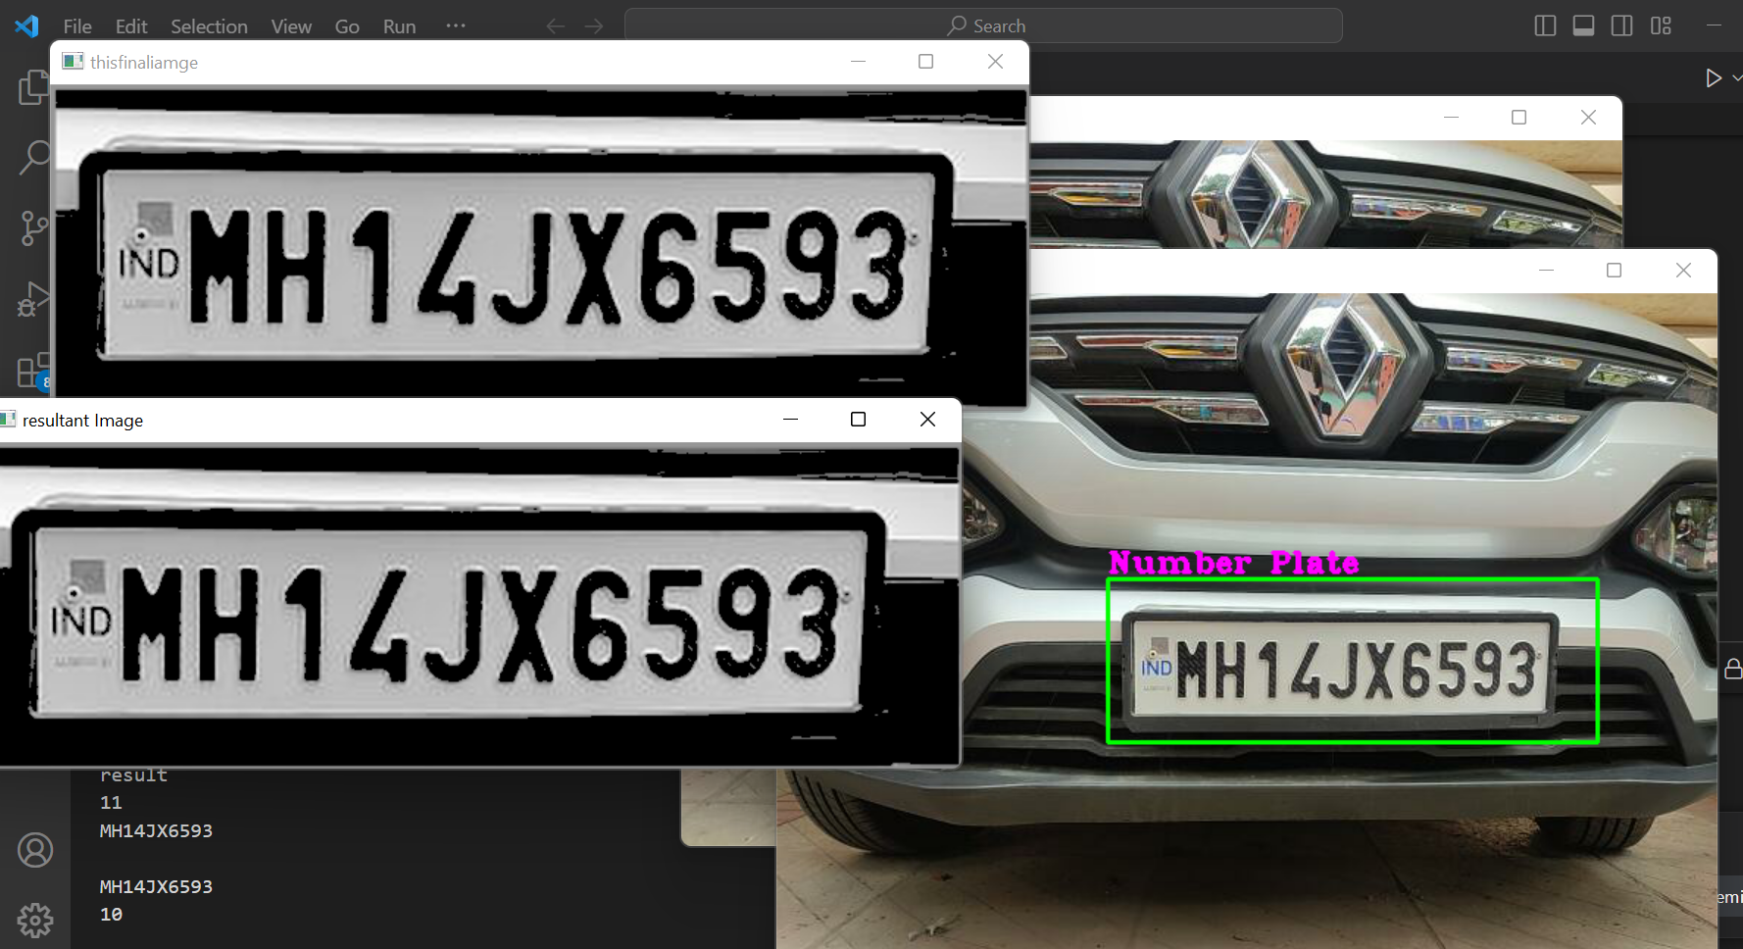

Slide 24
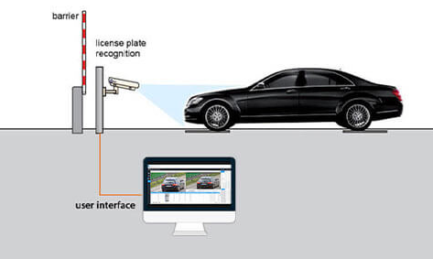
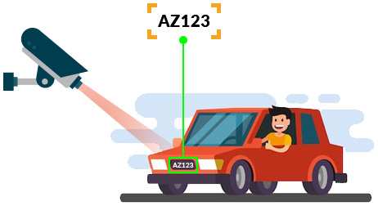
Test cases
1] When the nameplate is detected successfully and matches with the student record in database
2] When the nameplate is detected and matches with the staff record in database
3] When the nameplate is detected successfully and matches no one meaning it is a guest vehicle which doesn’t exist in database

Slide 25
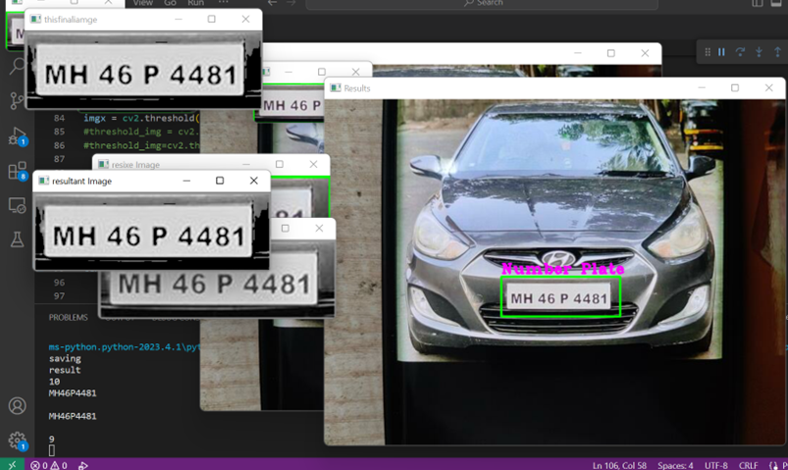
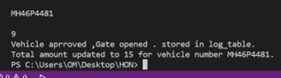
When the nameplate is detected successfully and matches with the student record in database

Slide 26
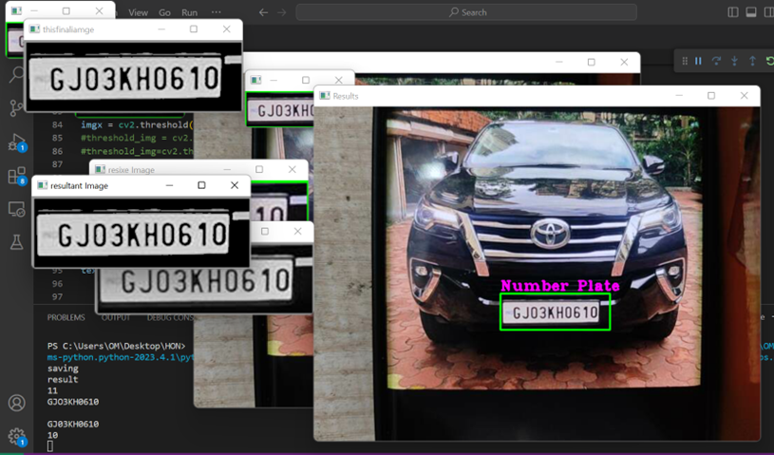
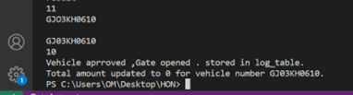
When the nameplate is detected and matches with the staff record in database

Slide 27
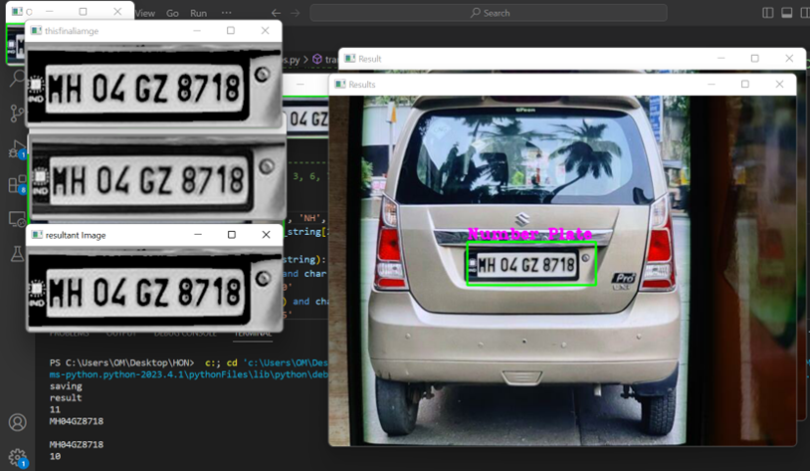
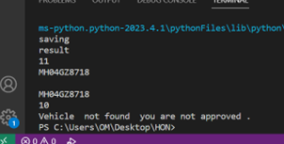
When the nameplate is detected successfully and matches no one meaning it is a guest vehicle which doesn’t exist in database

Slide 28
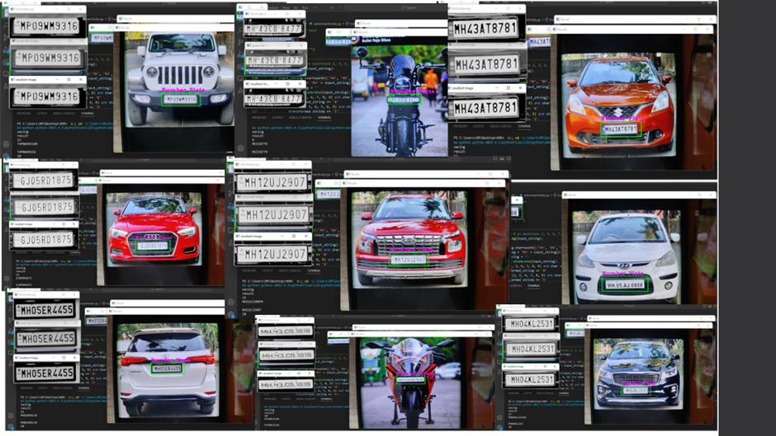

Slide 29
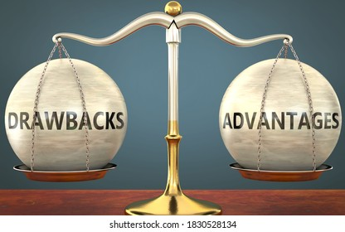
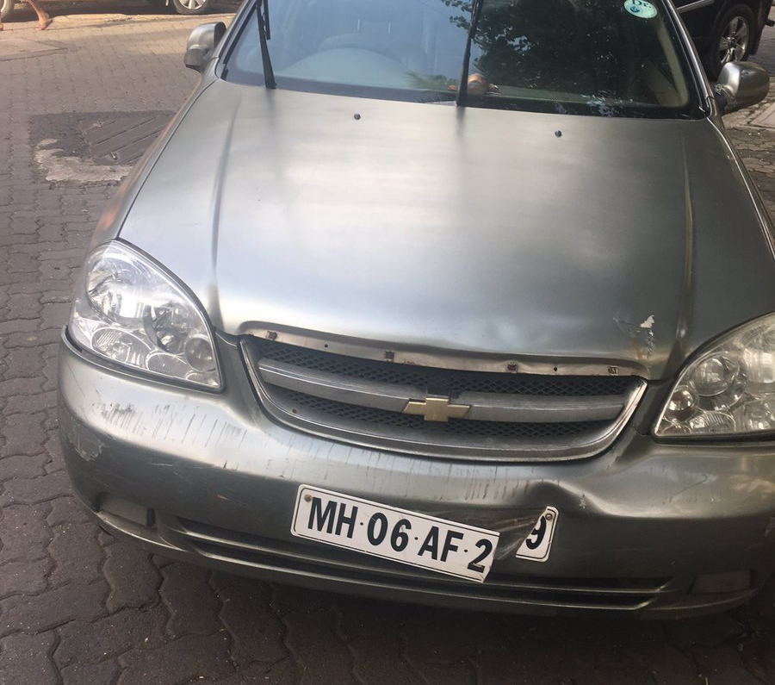
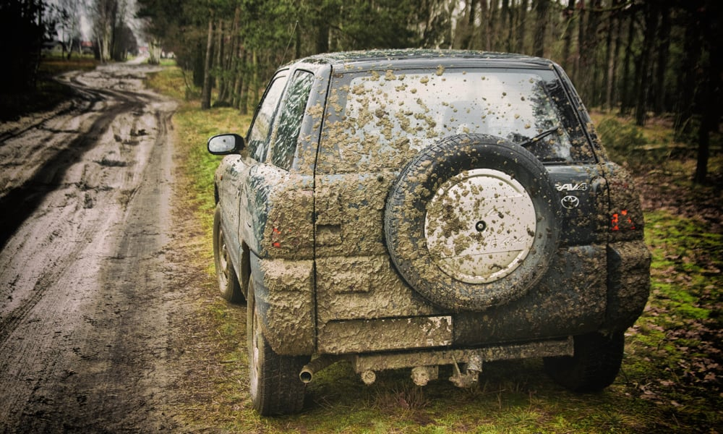
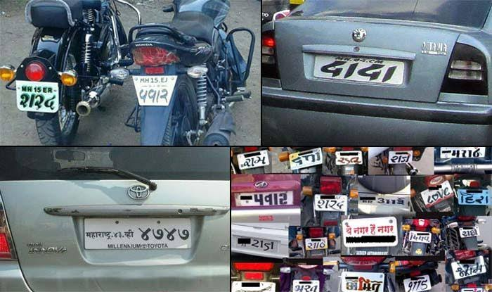
Drawbacks and limitations
Vehicles headlights which maybe on during nighttime may affect the image recognition accuracy and cameras autofocus not working properly may result in blurry images which are not suitable for the system to work.
Vehicle conditions also matter, i.e. the condition of the vehicle nameplate can really affect the result ,if the name plate is covered with dirt reading it will be really hard and almost no algorithm can find a way to read it .

Slide 30

Future enhancement and conclusion
We aim to add available parking space tracking which will alert the system when parking capacity has reached to its max limit and in order to have a control during crowded hours dynamically change the pricing based on the number of vehicles and day automatically.

Slide 31

Bibliography
https://www.geeksforgeeks.org/image-processing-in-python-scaling-rotating-shifting-and-edge-detection/
https://docs.opencv.org/3.4/db/d28/tutorial_cascade_classifier.html
https://www.analyticsvidhya.com/blog/2021/09/a-beginners-guide-to-image-processing-with-opencv-and-python/
https://techvidvan.com/tutorials/python-project-license-number-plate-recognition/
https://www.section.io/engineering-education/license-plate-detection-and-recognition-using-opencv-and-pytesseract/

Slide 32
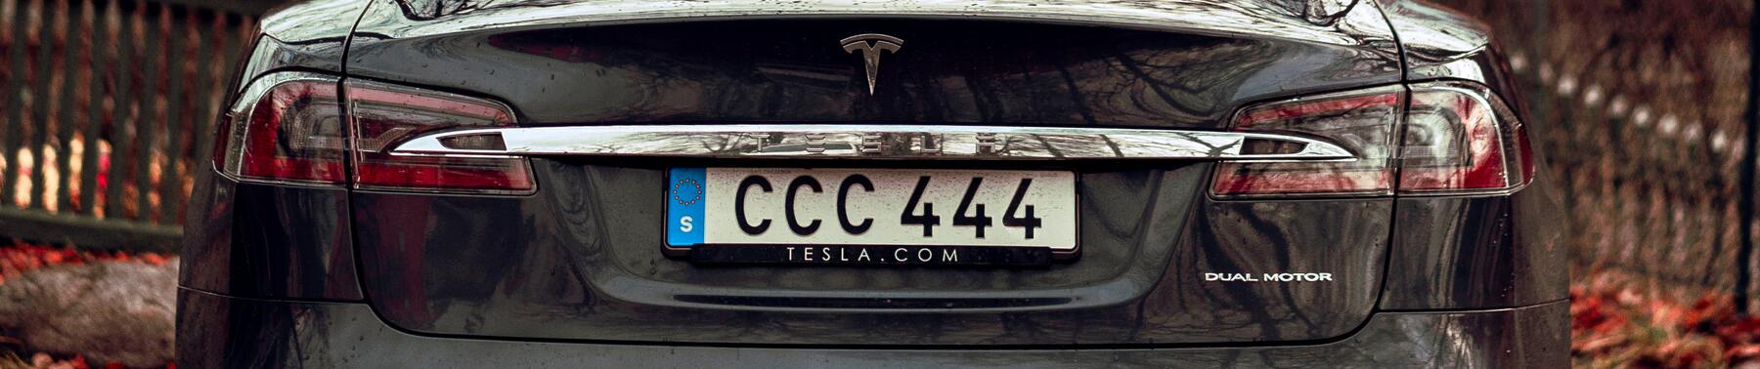

Thankyou

